Slide 1
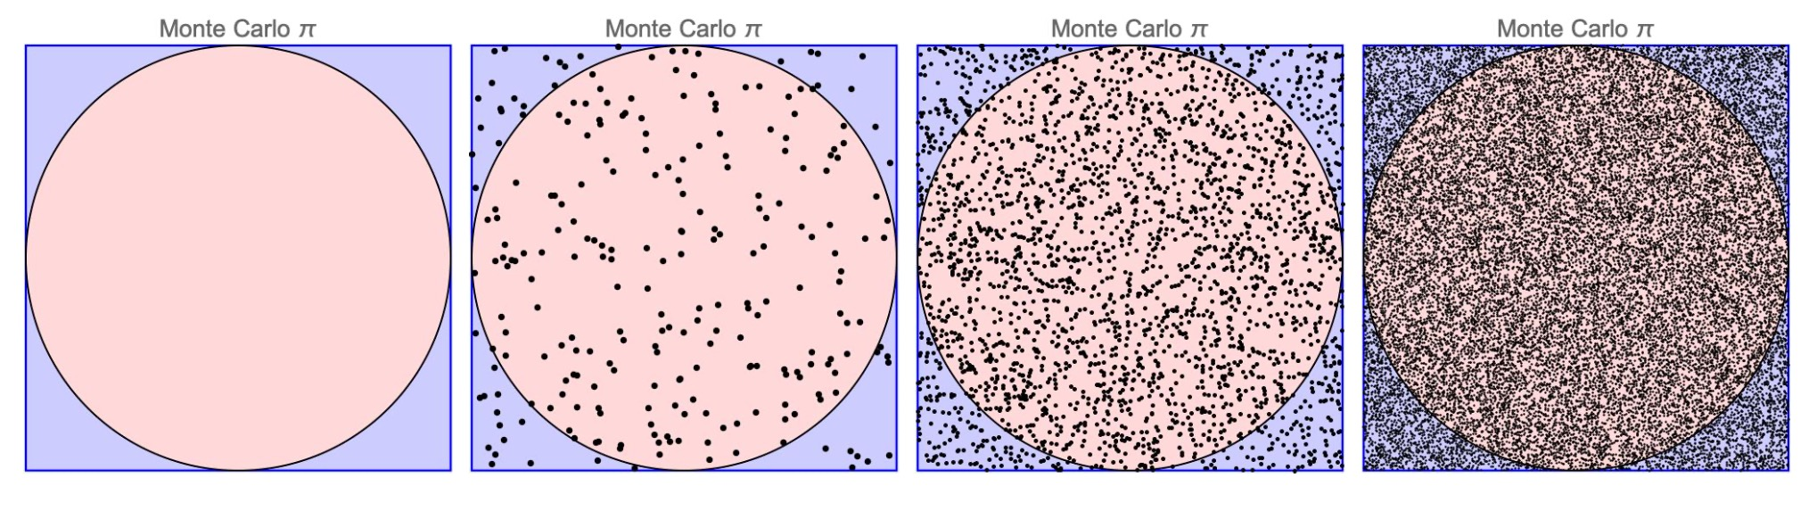
Malliavin calculus and its application in ﬁnancial mathematics
Université de Paris - M2MO
Monte Carlo Methods for Finance
Professor: Frikha Noufel
11/02/2022
Yeliang TANG
Nuoya SHAO
Zeyuan WU

Slide 2
Contents
Theoretical background
Diffusion model and definition of Greeks
Malliavin calculus
Localized Malliavin calculus
Implementation of different methods
Malliavin calculus
Localized Malliavin
Finite Difference by Monte Carlo
Finite Difference by PDE
Simulation result
Conclusion

Slide 3
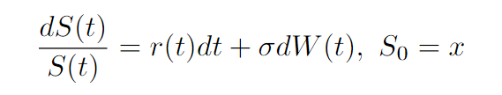
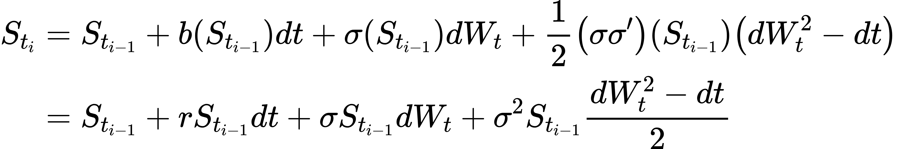
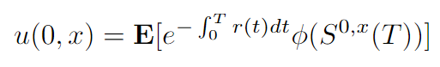
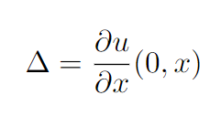
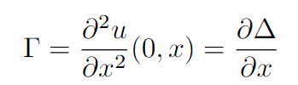
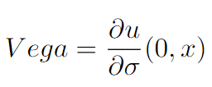
1. Theoretical Background Diffusion model and definition of Greeks
Milestein schema :
Greeks :
Option price :

Slide 4
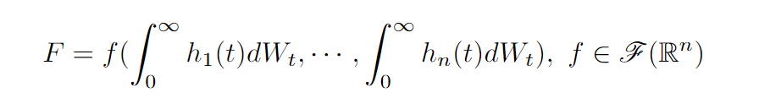
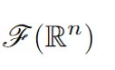
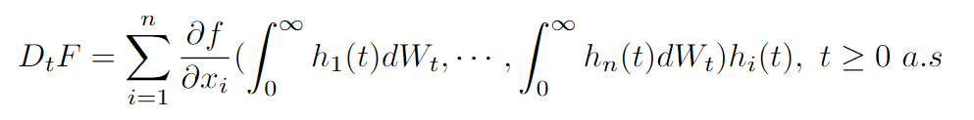
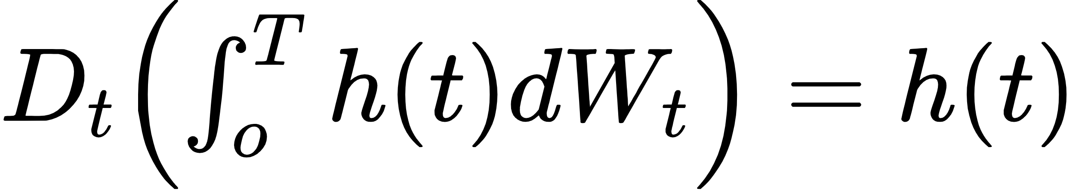
1. Theoretical Background Malliavin calculus : Malliavin derivative
We consider function in this form :
where
denotes the set of infinitely differentiable and rapidly decreasing function
The Malliavin derivative DF of F is then defined as
Examples :

Slide 5

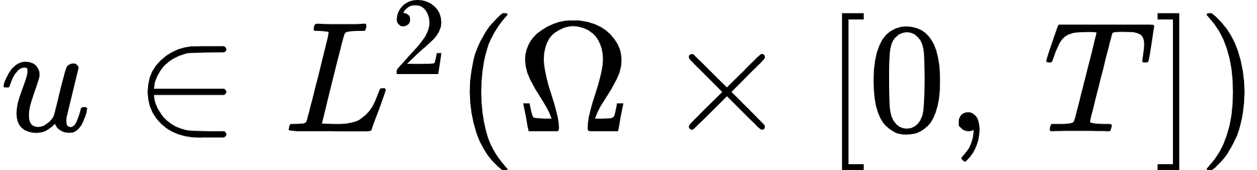
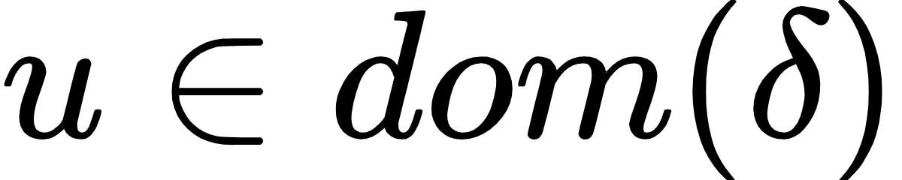
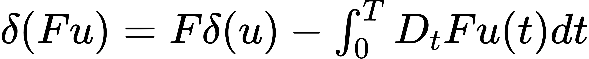
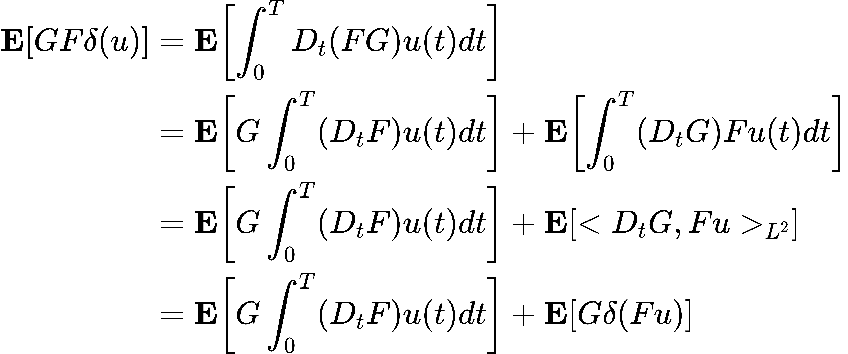
1. Theoretical Background Malliavin calculus : Skorohod integral
Skorohod integral is defined as the adjoint of the Malliavin derivative
Domain of
: the set of random variables
such that
Characteristic :
For
Proof:

Slide 6
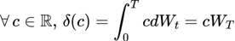
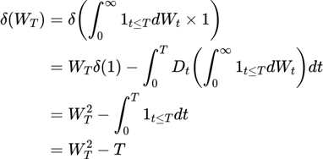
1. Theoretical Background Malliavin calculus : Skorohod integral
For
Examples :
Skorohod integral can be seen as the extension of Ito's integral, for an adapted process, Skorohod integral equals Ito's integral

Slide 7
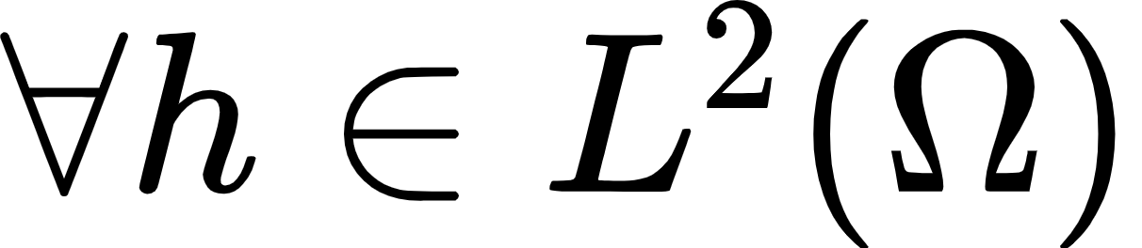
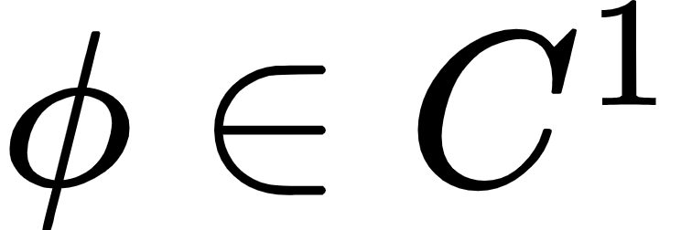
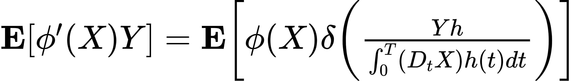
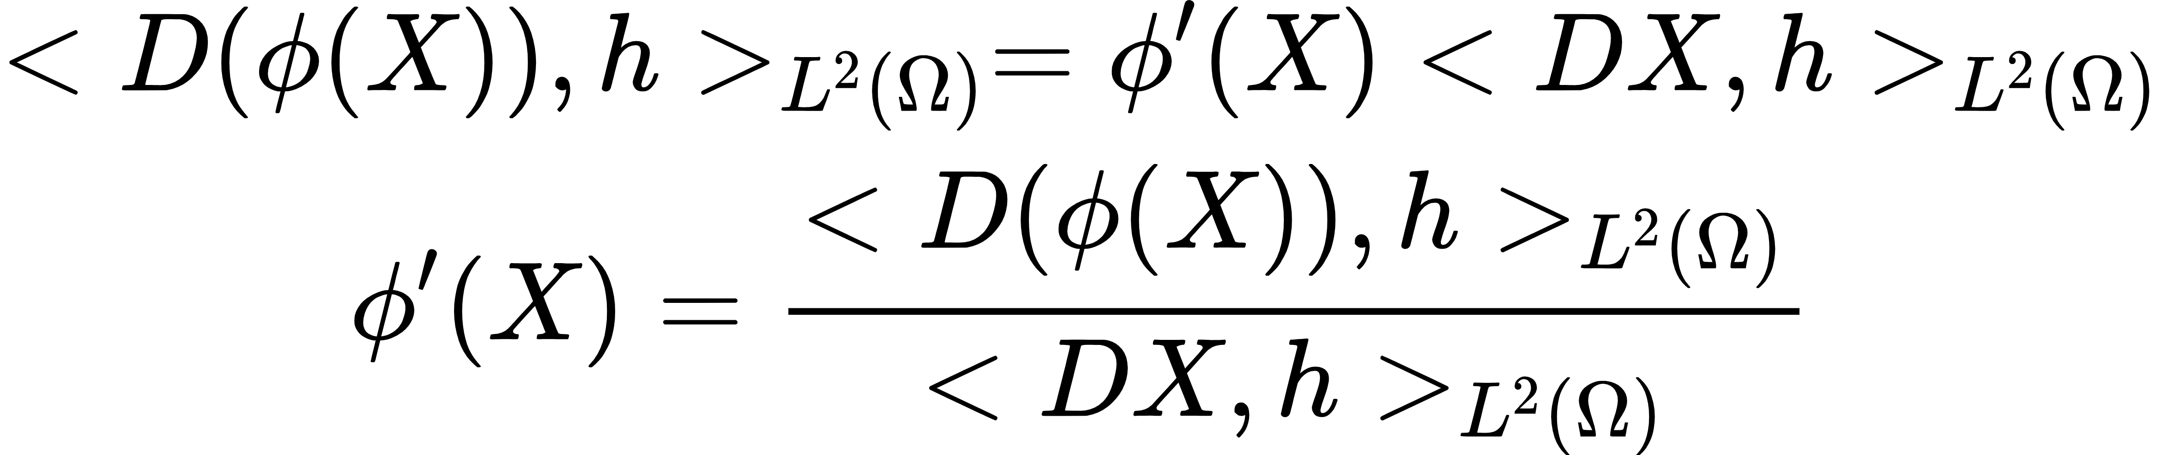
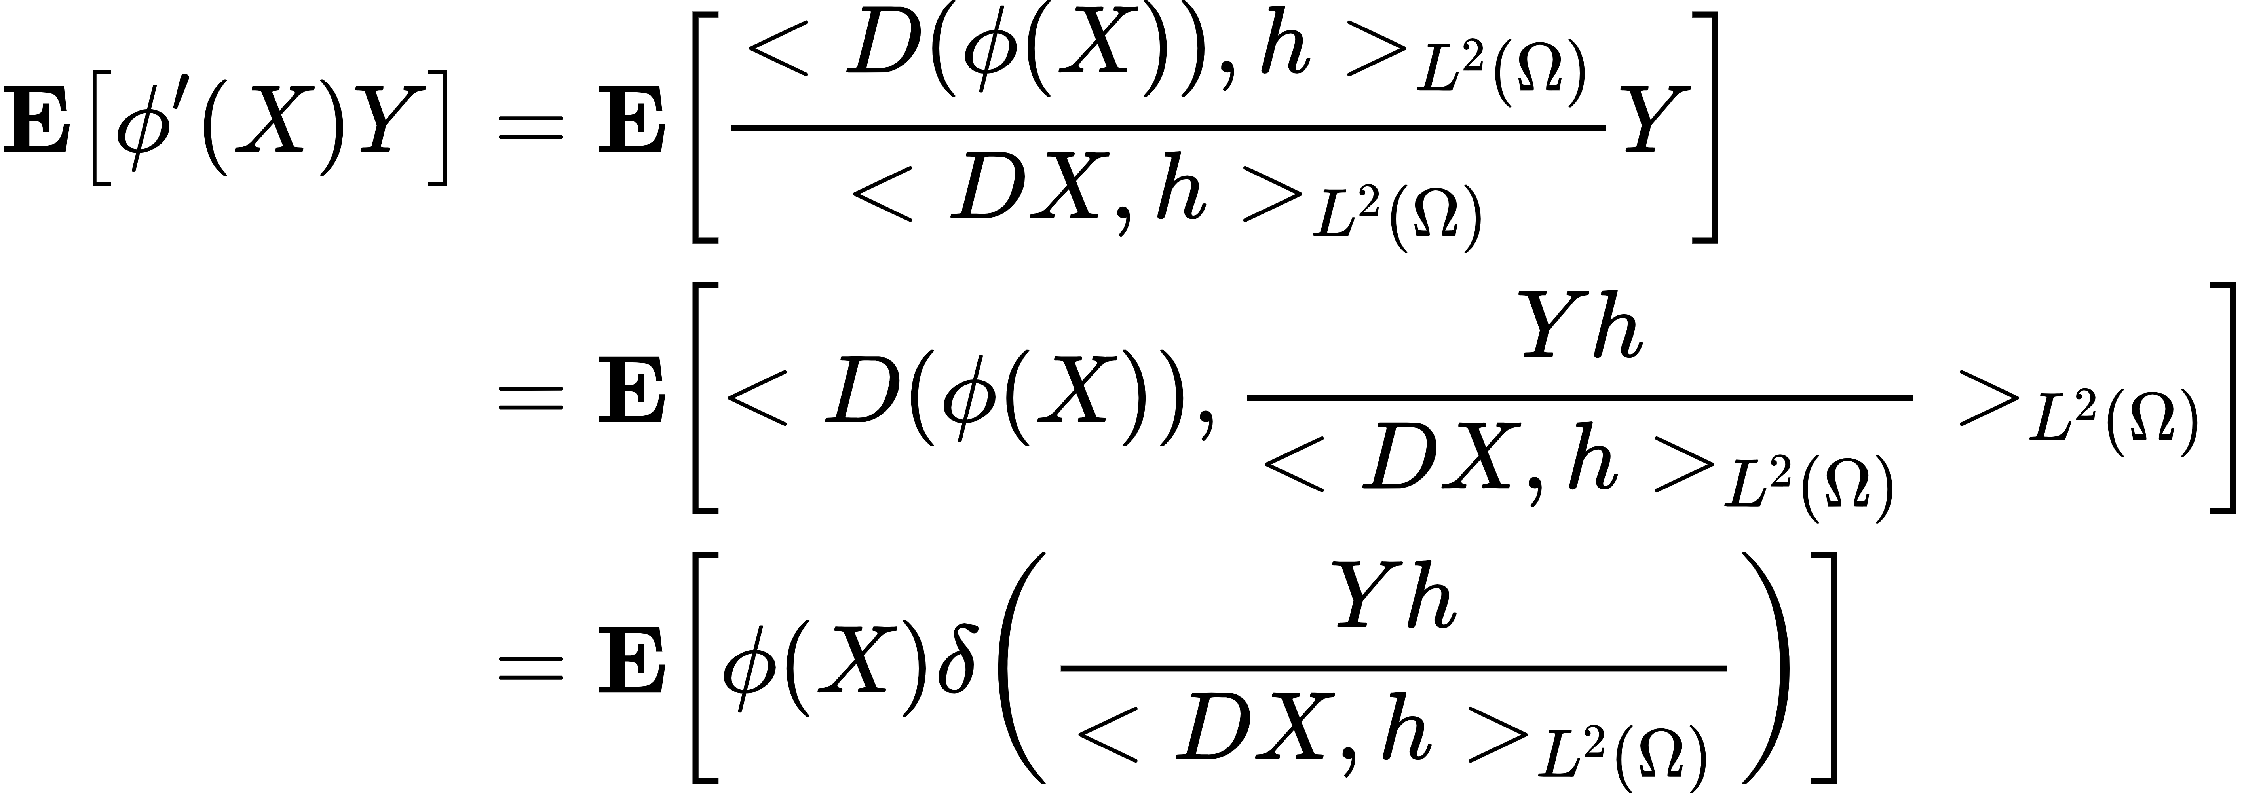
1. Theoretical Background Malliavin calculus : Integration by parts formula
Given X, Y two random variables
, we have
Proof:
By chain rule :
then :
By characteristic
For continuous functions with jump discontinuities and linear growth, this formula still holds

Slide 8
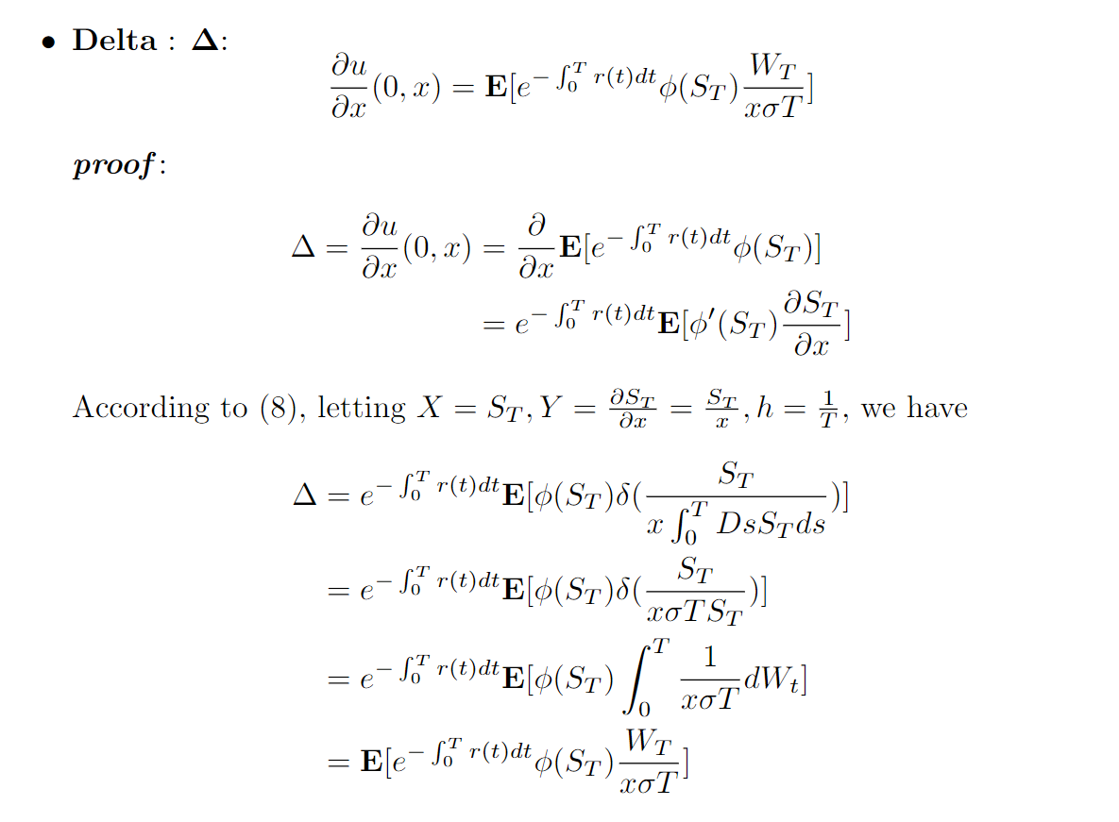
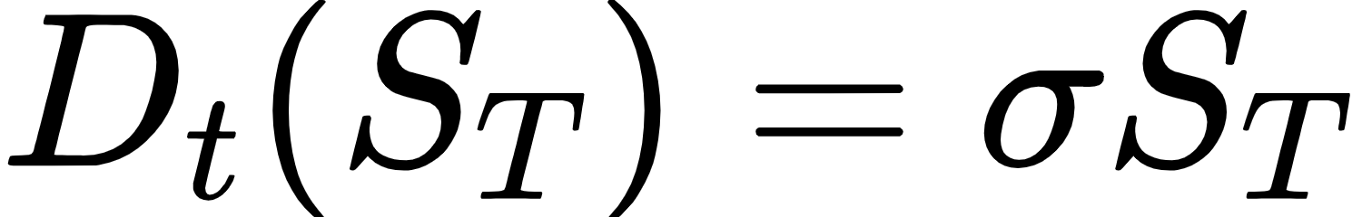
2. Implementation of different methods
Malliavin calculus : European call option

Slide 9
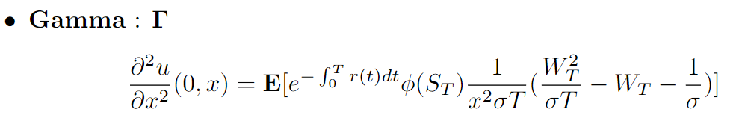
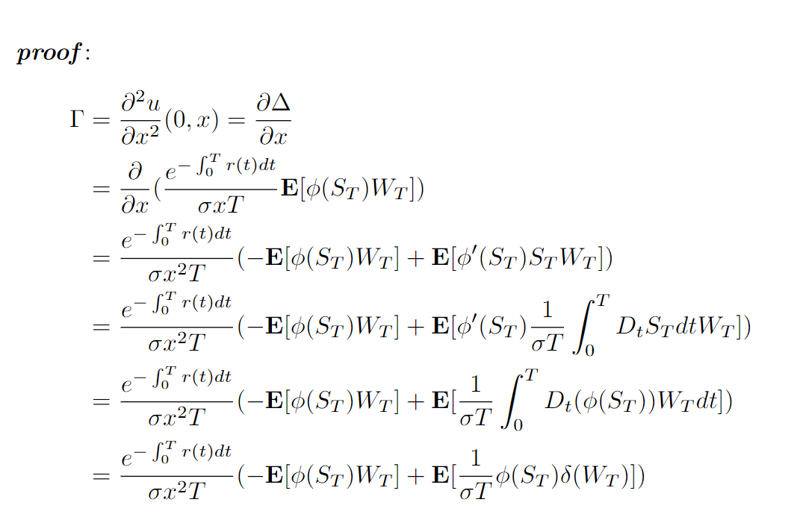
2. Implementation of different methods
Malliavin calculus : European call option

Slide 10
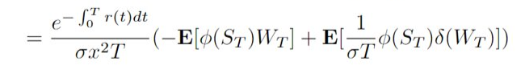
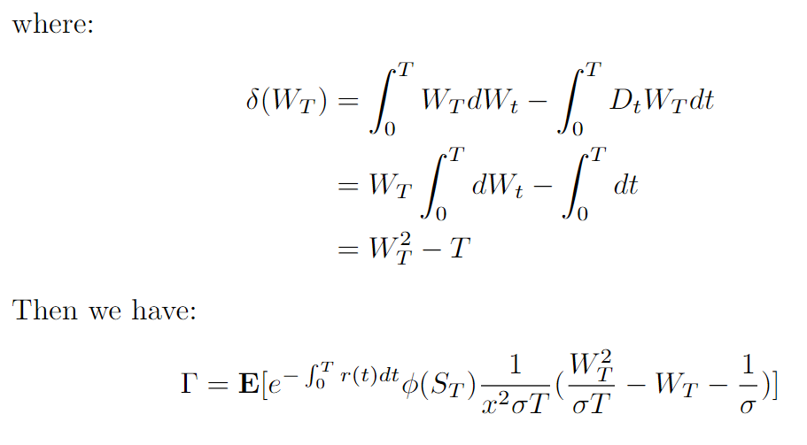
2. Implementation of different methods
Malliavin calculus : European call option

Slide 11
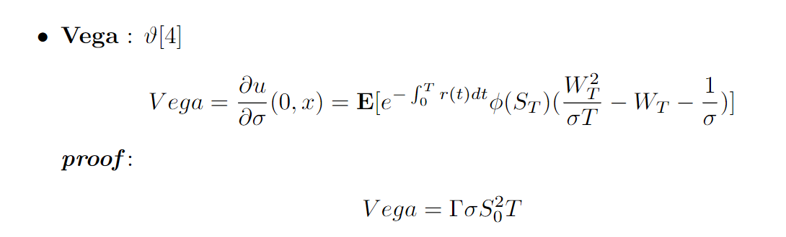
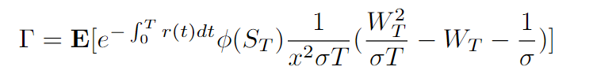
2. Implementation of different methods
Malliavin calculus : European call option

Slide 12
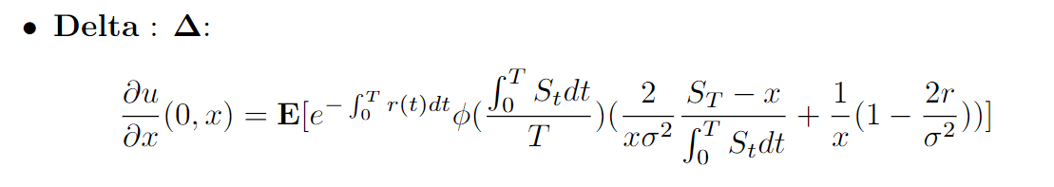
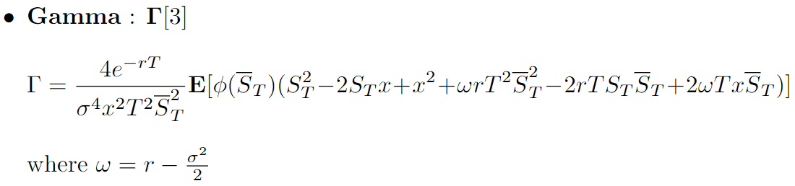
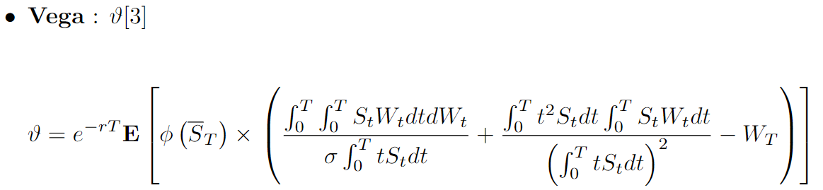
2. Implementation of different methods
Malliavin calculus : Arithmetic Asian call option

Slide 13
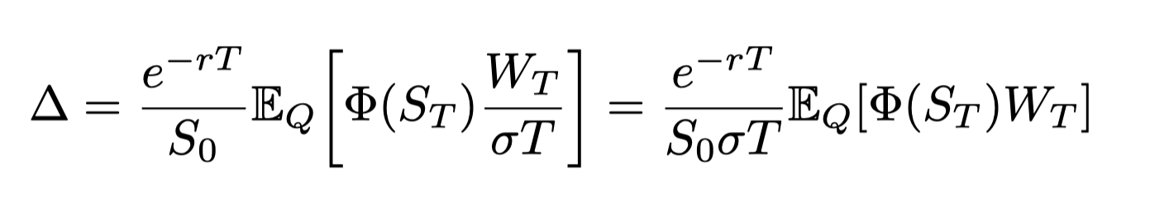


2. Implementation of different methods
Localized Malliavin calculus : General idea
The Malliavin formulae creates weights which involve powers of the Brownian Motion
We localize the integration-by-parts around the singulairites
These global weights which have large variance
may slow down Monte Carlo simulations

Slide 14
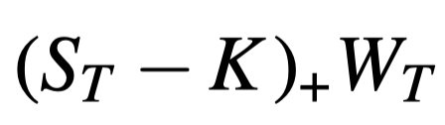
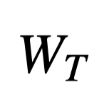
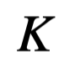
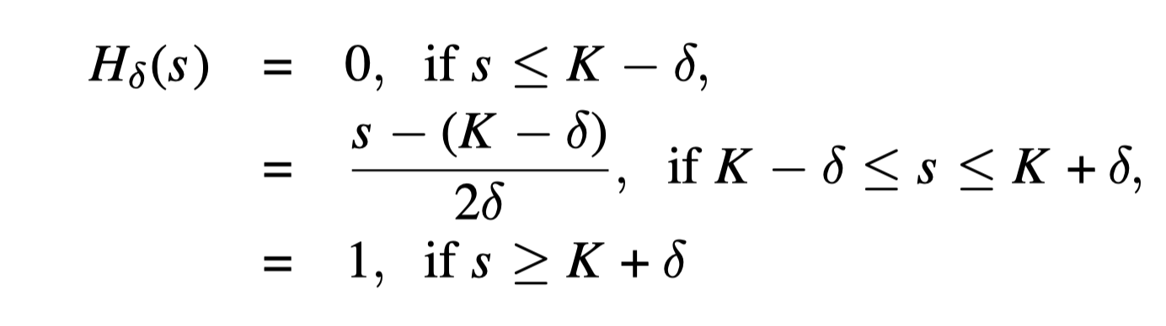
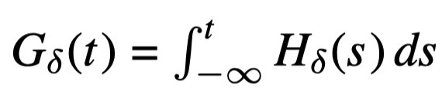
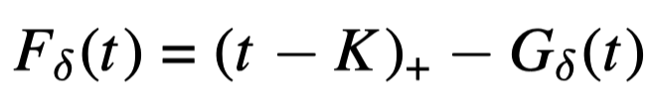
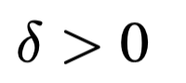
2. Implementation of different methods
Localized Malliavin calculus : European call option
The term is “very large” when is "large" and has a "large" variance.
idea to solve this difﬁculty: to introduce a localization around the singularity at
Idea: We let the slope increase continuously
Is the localization parameter

Slide 15
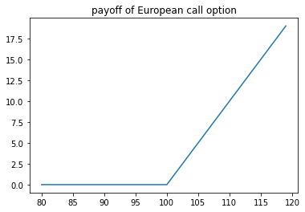
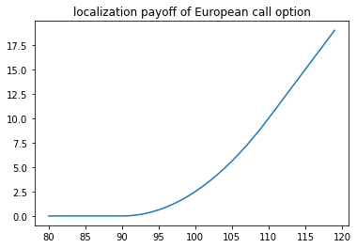
2. Implementation of different methods
Localized Malliavin calculus : European call option
Singularity at K = 100
Smooth function, no singularity
Example with K = 100, localization parameter = 10

Slide 16
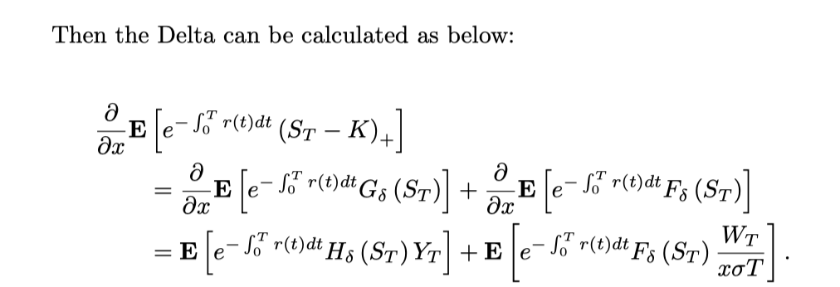
2. Implementation of different methods
Localized Malliavin calculus : European call option
The term with Brownian Motion which has potentially large variance is reduced
The variance is reduced

Slide 17
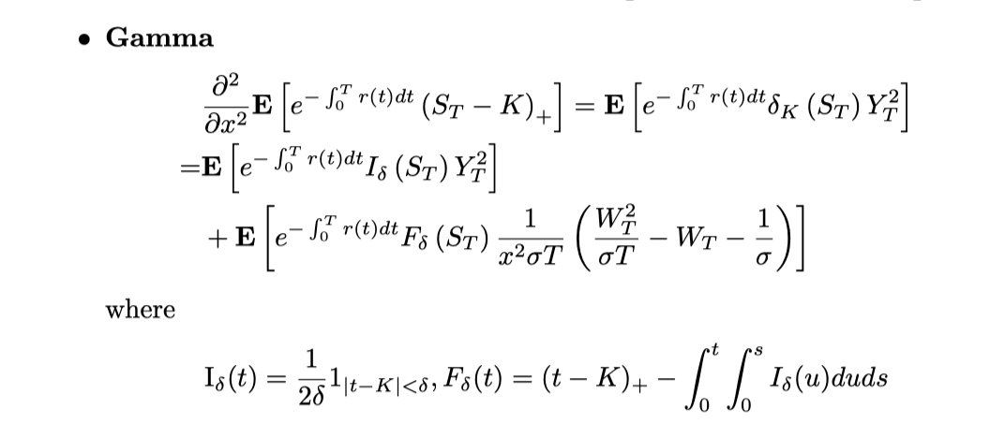
2. Implementation of different methods
Localized Malliavin calculus : European call option
The same method applies to Gamma, we use the same smoothed version of payoff function

Slide 18
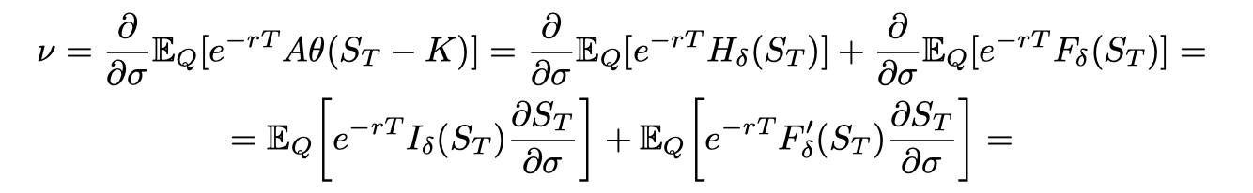


2. Implementation of different methods
Localized Malliavin calculus : European call option
The same method applies to Vega

Slide 19
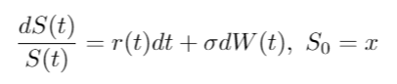
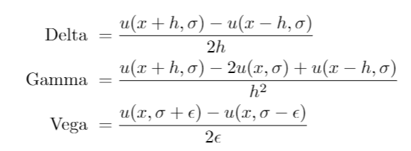
2. Implementation of different methods
Finite Difference by Monte Carlo
In the scheme of BS, the dynamic of the underlying is
For getting the Delta, Gamma and Vega, get started with the following pricing equation:
Then

Slide 20
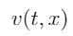
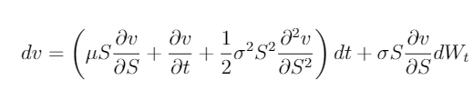

2. Implementation of different methods
Finite Difference by PDE
In the scheme of BS, the dynamic of the underlying is
In the case of European option, we get the differential term w.r.t the price of the option by Itô formula :
The actualised value of is a martingale according to AOA .

Slide 21



2. Implementation of different methods
Finite Difference by PDE
In more general case, let be the infinitesimal generator of the SDE :

Slide 22


2. Implementation of different methods
Finite Difference by PDE
Thus, we get a simplified form of PDE :
The space derivatives are approximated by centered differences:

Slide 23



2. Implementation of different methods
Finite Difference by PDE
The time derivatives are more complicated. In the explicit scheme:
where the terminal condition is the option’s pay-off :

Slide 24

2. Implementation of different methods
Finite Difference by PDE
==> the explicit scheme is conditionally stable
==> a very small time step may be required to ensure stability

Slide 25


3. Simulation result European call option: delta, vega
S0 = 100, K = 100, sigma = 0.2, r = 0, T = 1

Slide 26


3. Simulation result European call option : gamma
S0 = 100, K = 100, sigma = 0.2, r = 0, T = 1

Slide 27


3. Simulation result Arithmetic Asian call option : delta, gamma
S0 = 100, K = 100, sigma = 0.2, r = 0, T = 1

Slide 28
4. Conclusion
Pros :
Malliavin method can significantly reduce the variation while calculating the Greeks, especially for the case of non smooth pay off function where the ordinary Monte Carlo method works extremely poorly.
With localized Malliavin method, we can expect a better result. In the meantime,
Cons:
we should also notice that even the Malliavin can provide a good result, the formula for exotic option can be extremly complex, which may not be so efficient.

